Slide 1
Packet Sniffer
.

Slide 2
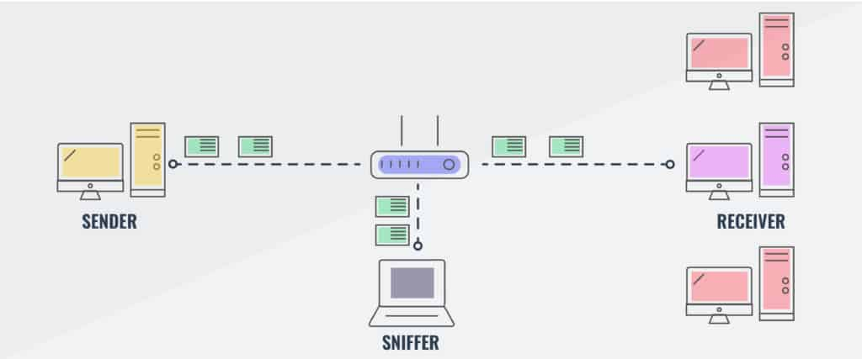
Packet Sniffers
Packet sniffer is an software application or program that performs packet sniffing and Packet sniffing is a process or technique of monitoring and capturing all data packets passing through a software, network, hardware devices.
Notes:
Packet sniffer is an application or program that performs packet sniffing and Packet sniffing is a process or technique of monitoring and capturing all data packets passing through a software, network, hardware devices. Many system administrator or network administrator use it for monitoring and troubleshooting network traffic. Packet sniffers are useful for both wired and wireless networks or we can say that, It works on both switched environment and non-switch environment. It works by intercepting traffic data as it passes over the wired or wireless network and copying it to a file. It is called as packet capture.

Slide 3
What can be sniffed?
One can sniff the following sensitive information from a network
Email traffic
FTP passwords
Web traffics
Telnet passwords
Router configuration
Chat sessions
DNS traffic

Slide 4
How does packet sniffing works
A network is a collection of nodes, such as personal computers, servers, and networking hardware that are connected. The network connection allows data to be transferred between these devices. The connections can be physical with cables, or wireless with radio signals. Networks can also be a combination of both types.
Notes:
As nodes send data across the network, each transmission is broken down into smaller pieces called packets. The defined length and shape allows the data packets to be checked for completeness and usability. Because a network’s infrastructure is common to many nodes, packets destined for different nodes will pass through numerous other nodes on the way to their destination. To ensure data is not mixed up, each packet is assigned an address that represents the intended destination of that packet.
A packet’s address is examined by each network adapter and connected device to determine what node the packet is destined for. Under normal operating conditions, if a node sees a packet that is not addressed to it, the node ignores that packet and its data.

Slide 5
Types of Sniffing
Popular sniffing tools
Active Sniffing:
Passive Sniffing:
Some Active Sniffing Techniques
MAC Flooding
DHCP Attacks
DNS Poisoning
ARP Poisoning
Wireshark.
tcpdump.
Kismet.
EtherApe
Cain and Abel.
NetworkMiner.
Notes:
Active sniffing – this is sniffing that is conducted on a switched network. A switch is a device that connects two network devices together
Passive sniffing – passive sniffing uses hubs instead of switches.they use Hubs for perform to do use MAC address to read the destination ports of data.
MACFlooding media access control attack In this attack the network is flooded with the fake MAC addresses. The hacker uses this attack to steal sensitive data that is being transferred in the network.
DHCP ATTACK Dynamic Host Configuration Protocol) the Attacker may send bogus request/replies luring the client to connect to attacker’s machine instead of valid DHCP server.
DNS POISONING Domain Name System they entering false information into a DNS cache, so that DNS queries return an incorrect response and users are directed to the wrong websites.
ARP poisoning, is a Man in the Middle (MitM) attack that allows attackers to intercept communication between network devices.

Slide 6
The Sniffing Effects on Protocols:
protocols do not offer much resistance to potential intruders. Following are the different protocols that lend themselves to easy sniffing −
HTTP
SMTP
NNTP
POP
FTP
IMAP
Telnet
Sniffers are not the dumb utilities that allow you to view only live traffic. If you want to analyze each packet, save the capture and review it whenever time allows.
Notes:
HTTP Hypertext Transfer Protocol It is used to send information in clear text without any encryption and thus a real target.
SMTP (Simple Mail Transfer Protocol) SMTP is utilized in the transfer of emails. This protocol is efficient, but it does not include any protection against sniffing.
NNTP (Network News Transfer Protocol) It is used for all types of communication. A major drawback of this is that data and even passwords are sent over the network as clear text.
POP (Post Office Protocol) POP is strictly used to receive emails from the servers. This protocol does not include protection against sniffing because it can be trapped.
FTP (File Transfer Protocol) FTP is used to send and receive files, but it does not offer any security features. All the data is sent as clear text that can be easily sniffed.
IMAP (Internet Message Access Protocol) IMAP is the same as SMTP in its functions, but it is highly vulnerable to sniffing.
Telnet Telnet sends everything (usernames, passwords, keystrokes) over the network as clear text and hence, it can be easily sniffed.

Slide 7
Approach:
Our main aim was to see the data flow in a network but in a network the data will be in machine readable so initially by using a function we will make it into human readable code and our program will keep on running and capturing all the packets in a particular network flowing while the program was in running state and when a packet is caught first it will unpack that packet in a particular format and return the ethernet prototype, destination mac address, source mac address and data and if the ethernet port number is 8 it means it belongs to ipv4 and then that ipv4 will return the version, header, TTL, prototype, source address, destination address and in that if the prototype is numbered in below specified protocols it will go to their specified functions to return their required information like ICMP returns ICMP type and header length, Time to live, prototype, source address same UDP returns source port, destination port, size, data similar for all the protocols

Slide 8
How Hackers are using Packet Sniffing
Packet sniffing hardware comprises a special device that can be connected to the network. These are carefully designed devices that collect packets from a hop. Often, hackers use packet sniffing hardware in chosen network segments. This is where they anticipate a certain kind of traffic flow. The hardware ensures that no piece of data is lost in the chosen flow too. Once the required data is collected, it would be stored in a temporary memory space or sent to another machine in the network. The ultimate move depends on how the sniffer has configured the hardware.
Once the raw packet data is captured, the packet sniffing software analyzes it and presents it in human-readable form so that the person using the software can make sense of it. ... Hackers use sniffers to eavesdrop on unencrypted data in the packets to see what information is being exchanged between two parties

Slide 9

Is sniffing is legal
Packet sniffing is legal so long as you filter out data after the 48th (or 96th or 128th) byte.” “Capturing content may be illegal, but capturing non- content is fine.”

Slide 10
Conclusion
Packet sniffing attacks happen daily. Now and then, sniffers are using their hardware and network configuration tools to sniff data from networks. The best way to handle these attacks and avoid them is by using a private network that is both safe and secure. Also, you need to make use of protocols that have “security” as a part of its game plan. It

Slide 11

Thank you

